Slide 1

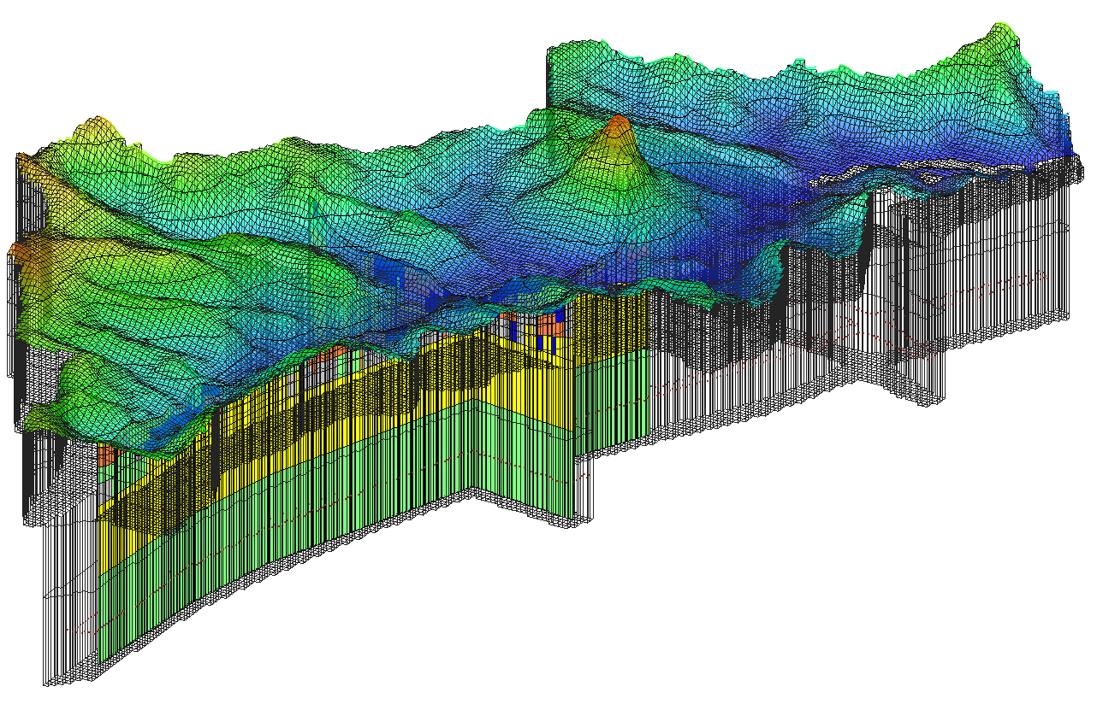
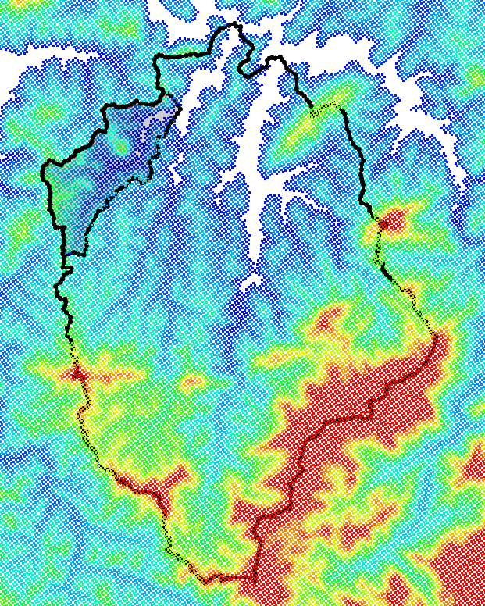
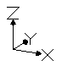
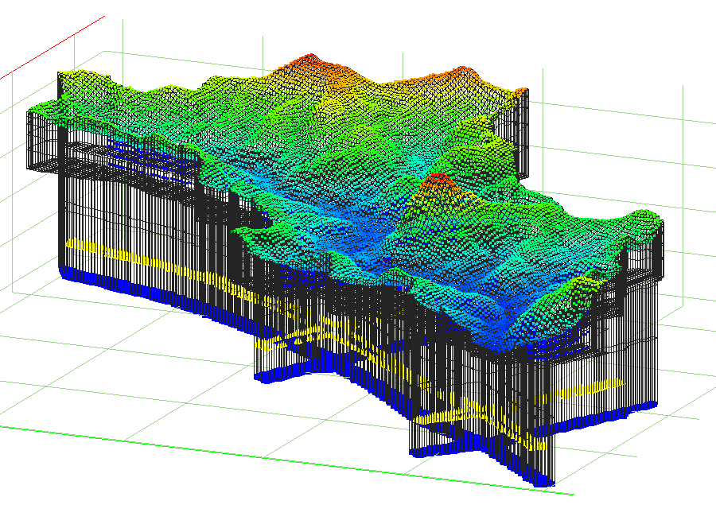

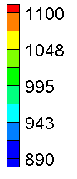
Não deixando de seguir o sugerido modelo conceitual, ..das águas Caxambu,
Projeções GHB, Carga Hidráulica fixa, mediada por condutâncias
.. propõe-se um enfoque dual: Aquíferos poroso e fraturado via calibração GHB.
1
2
(Z)
Posições
Caxambu 3D
Caxambu
Meio Poroso Equivalente
Domínios de referência
1 Regional
2 Local
Opções
prévias, GHB
1.200
1.120
1.045
970
890 m
GHB
MPE
0 2,5 5 km
2024 - www.betami.com.br
Beta μ
Notes:
This MODFLOW simulation has been thought to extract, quickly, the largest amount of information from the available database - SIGA.
First, there is the imperative need to deliver a workable strategy to address, concurrently, all the possible contributions of both, regional (fracture network) and local shallower aquifers. By the Equivalent Porous Medium approach, two domains are proposed: A long, deep but thin lower section of cells following the lineament patter just bellow the water course bed of Córrego Bengo. Then above it, an ordinary finite difference 25x25m grid representing all the alluvium and subbasin strata.
This design should pose to the calibration (the mathematical parameterization scheme) the opportunity, or the burden, of choosing the best set of conductance combinations to this GHB boundary condition.
The chart has what would be two versions of GHB topo heights. Then the taken positions (heads), followed by a projection on it, given the conductance results.

Slide 2
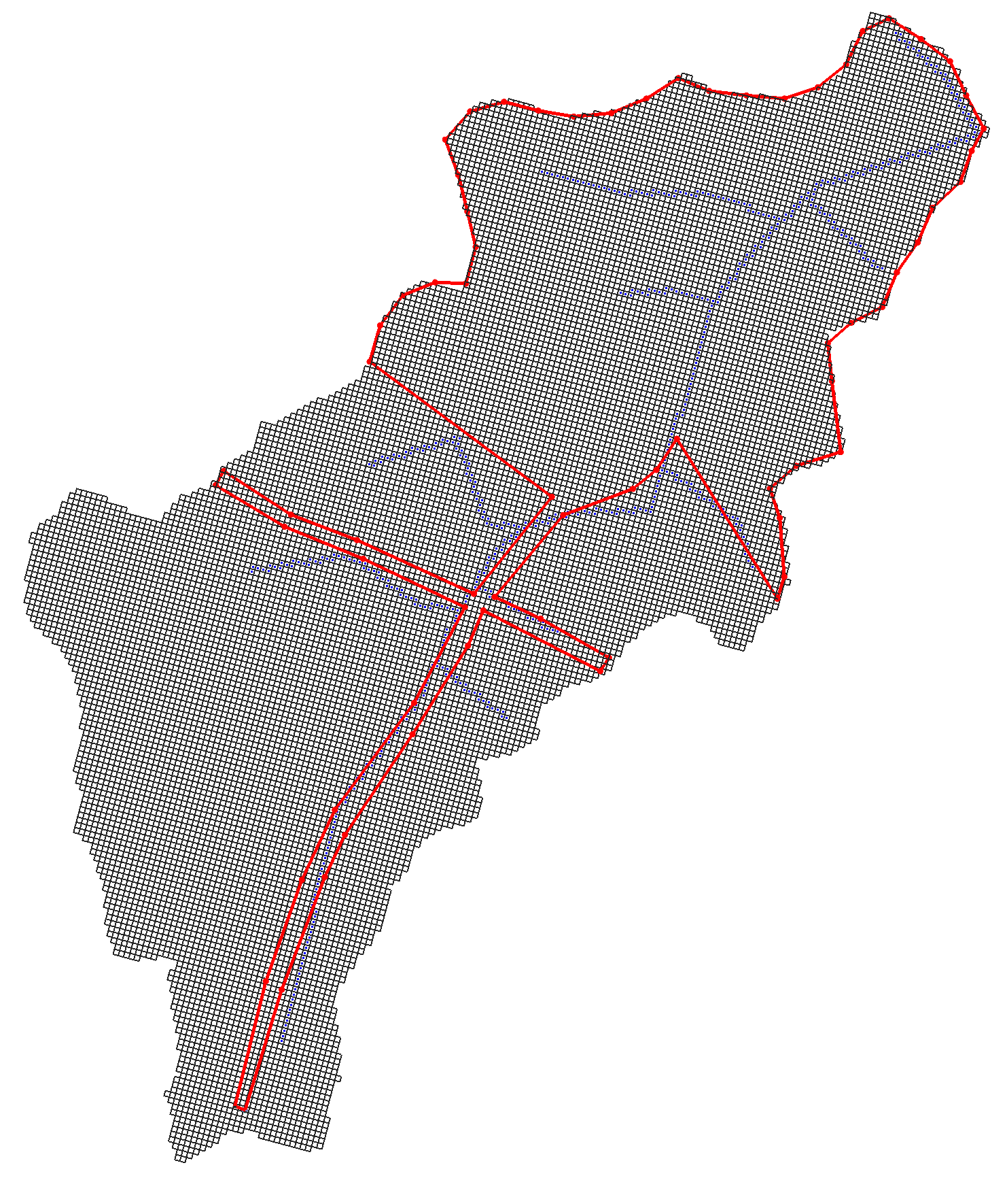
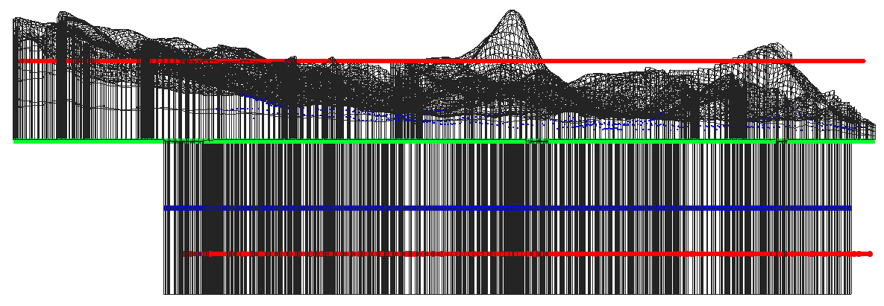
Condições de contorno
[no flux] – Sem carga fixa na microbacia. Divisor de águas de topo de morro. O próprio domínio fecha o modelo;
Drenos (DRN) em linguagem numérica, representam o caráter efluente dos cursos d’água observados em campo;
Recarga RCH - representam as chuvas, ±5% da vazão DRN;
33 unidades
32 unidades
RCH
Microbacia Caxambu
GHB – General head boundaries
Suas posições foram transferidas da borda para o centro do modelo, em profundidade.
DRN
21 unidades
986
(m)
847
730
580
no
Flux
Sem fluxo
nas laterais superiores
do bloco diagrama
Δh
GHB
GHB
2024 - www.betami.com.br
Beta μ
Notes:
Boundary conditions: - At the smallest scale and greatest numerical precision, no moisture can comes by into the watershed from the water divide, thus no flux.
Drains, Recharge and General Head Boundaries were positioned in a number believed to be adequate to increase the freedom of choices at the calibration.
The geophysics foresees the regional water income possibility. To achieve that, this numerical solution promises to keep its adherence to the conceptual model, planning a transference of “GHB pressures” from the supposed long distances of fractured flow, to the water course lineament beneath the river.
Besides all the restrictions and uncertainties involved in such proposed allocation of fractures and its interconnections, in the end it remains within the calibration process the responsibility to find where the bulk amount of water can or cannot flow, as needed, docking from outside into the model domain, by this lower boundary.

Slide 3
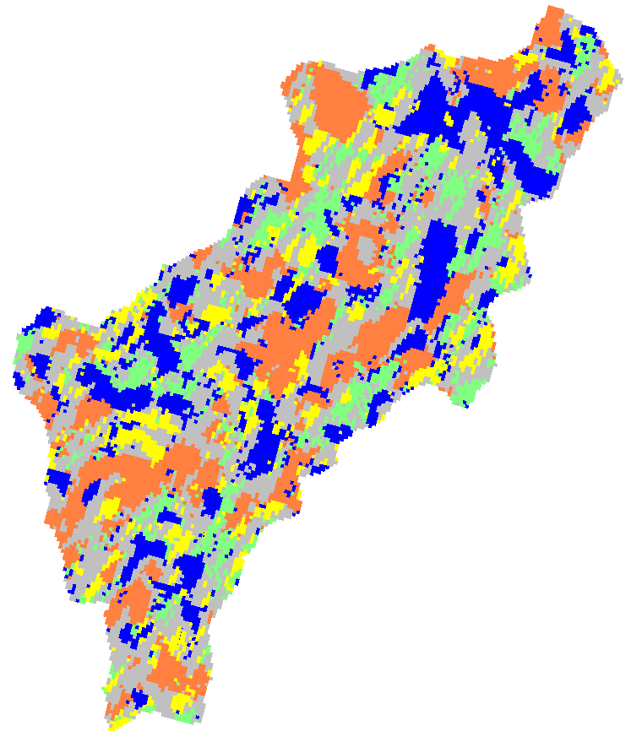
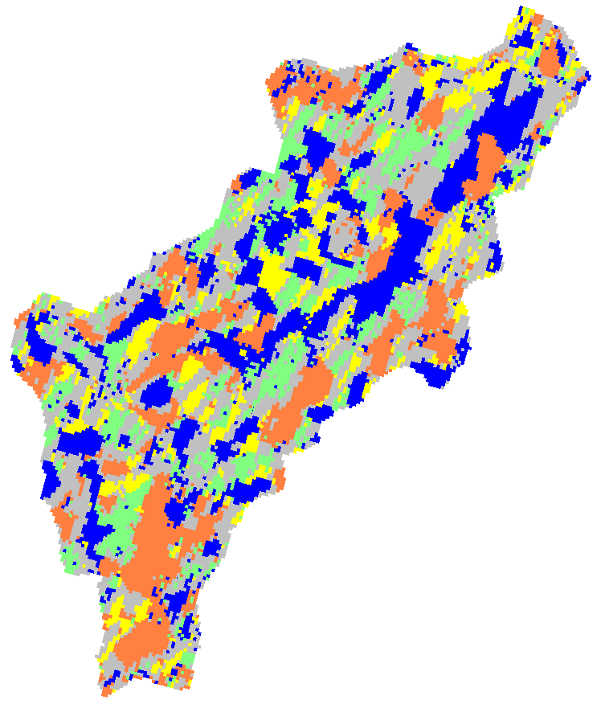
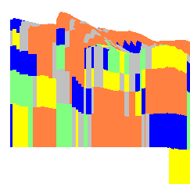
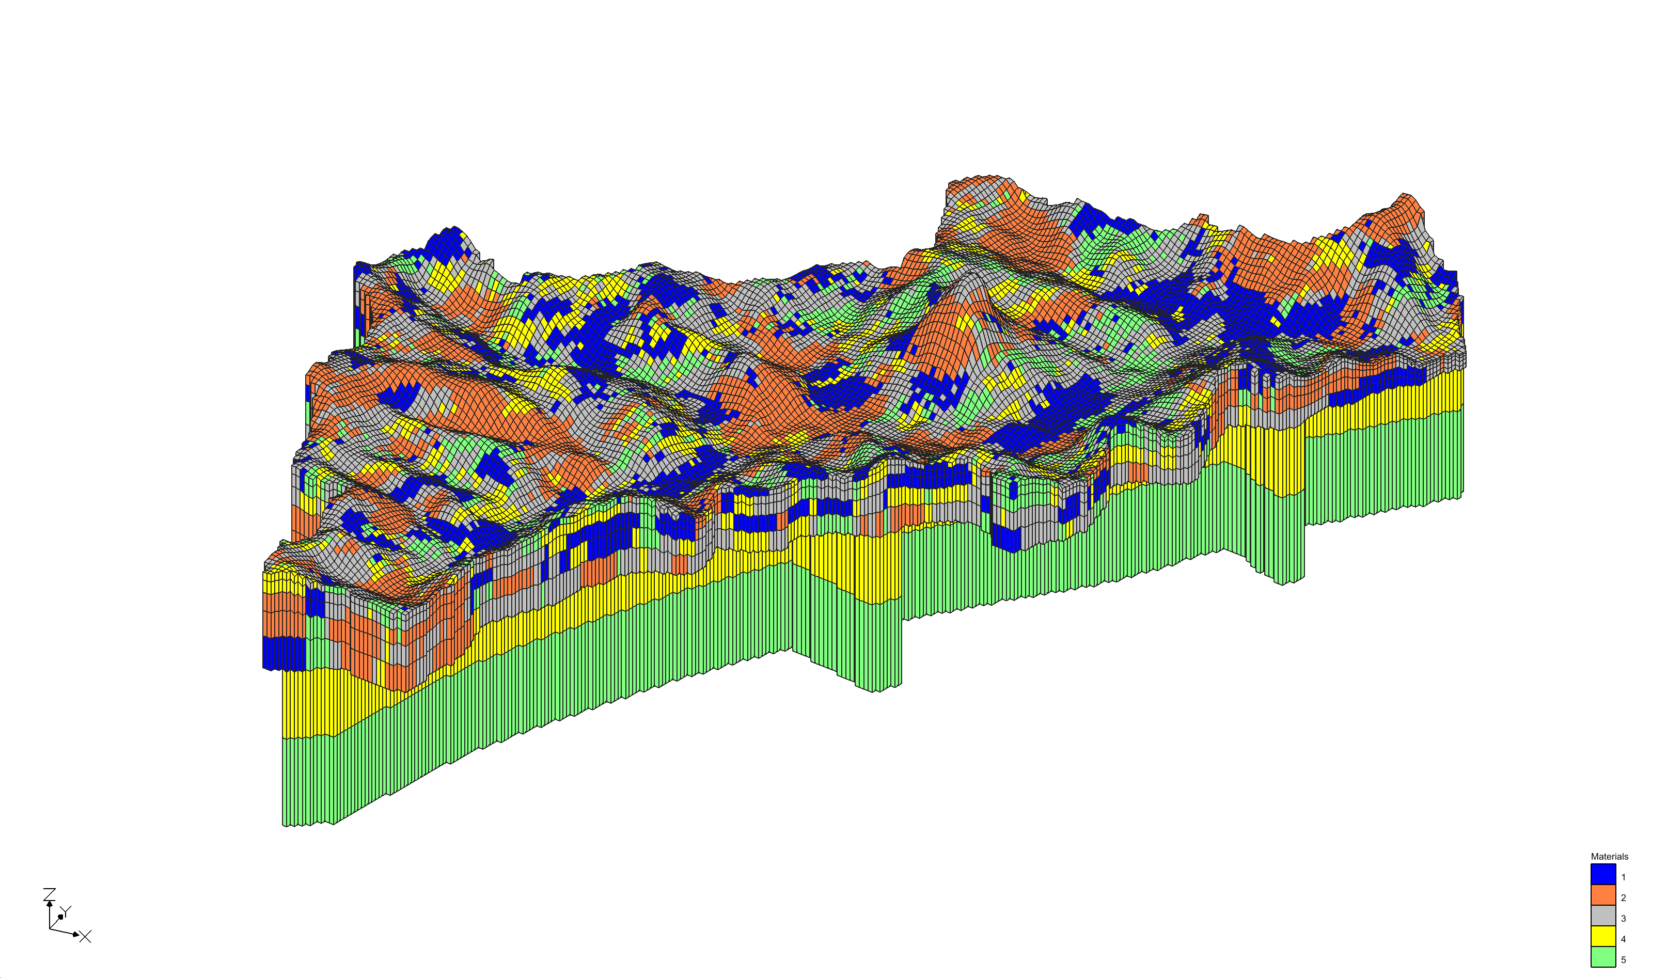
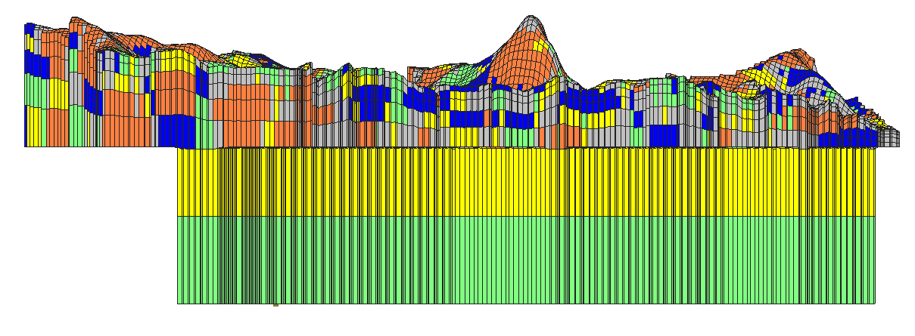
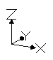
Condutividades Hidráulicas
Fácies sedimentares foram alocadas nas 05 camadas numéricas superiores,
via probabilidades
de transição.
Condutos de fluxo (02)
ocorrem apenas onde
estariam as fraturas.
Frequência
Comprimento
P_{j}(%) L_{k} (m)
direções
Z, xy
986
(m)
847
730
580
Fixo
+
2D
Pilot
Points
→
→
2024 - www.betami.com.br
Beta μ
Notes:
Hydraulic Conductivities:
This first, unsubsidized, independent numerical interpretation does not rely too much on the weight of upper layers material distributions and hydraulic conductivities.
Nonetheless, several precautions have been implemented to enhance the adhesion of the modelling premises to the reality.
The measures taken in this regard can be seen, for example, as a tight grid, followed by a crescent irregular thickness from top to bottom at its first 05 layers.
The interpolations follows the basin direction. Then the average lengths and recurrence of the would be most recent materials on top, stands in contrast with the would be justified presence of the same homogenous (yellow or green) exclusive space for the water flow at the “saturated, fractured rocks”, because the grid is laterally restricted after a certain depth. The flow in here is controlled by a combination of GHB conductances and pilot point material-bound hydraulic conductivities.

Slide 4
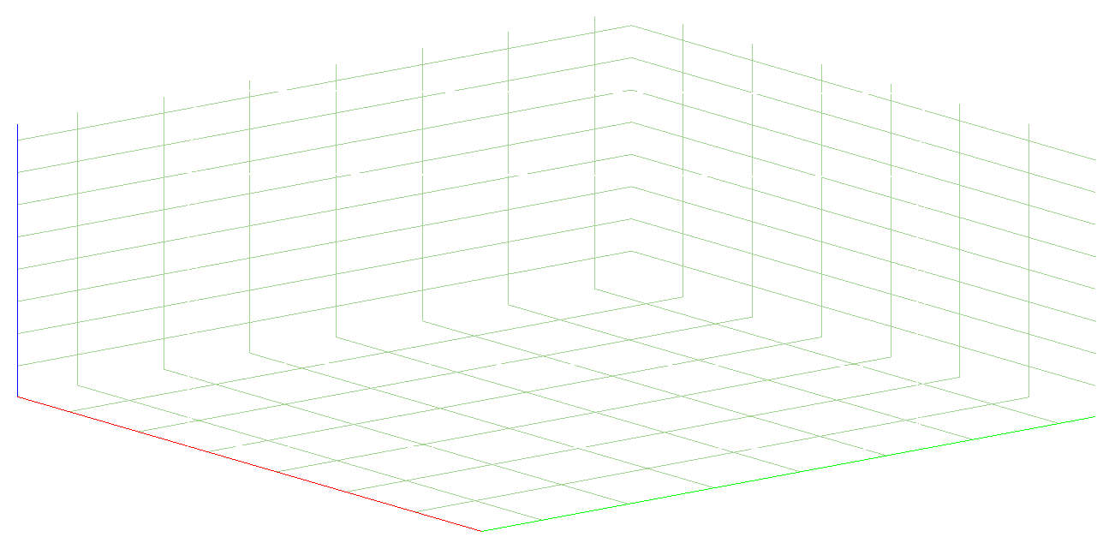
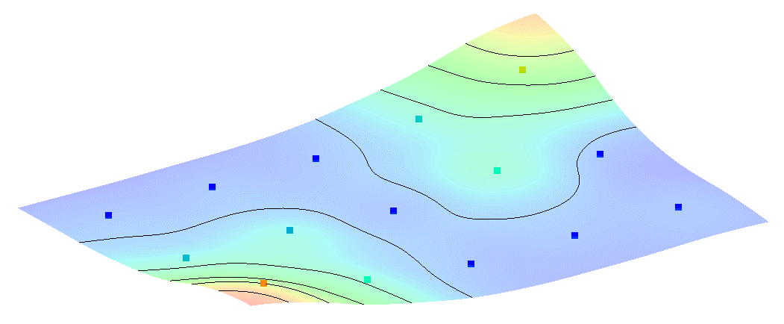
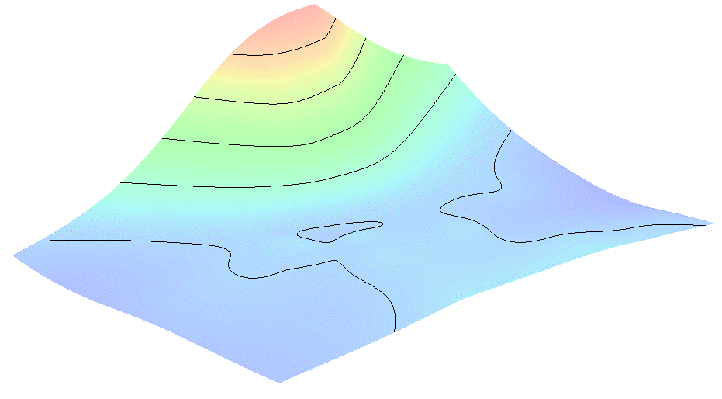
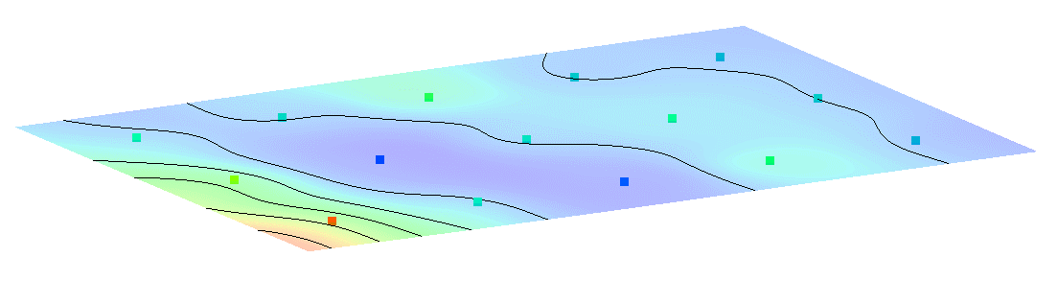
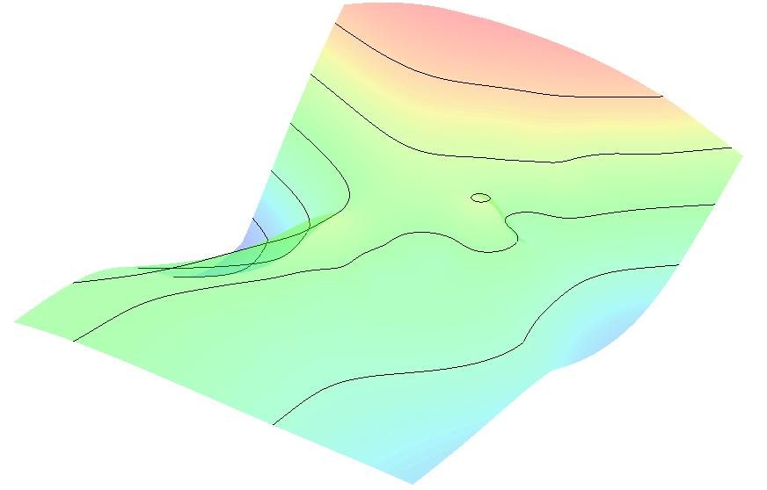
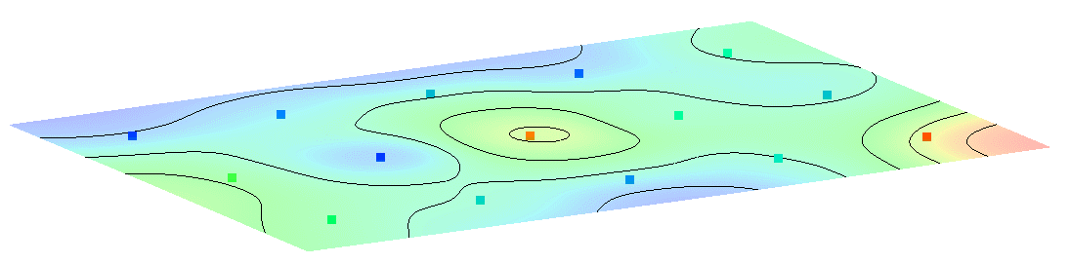
Parâmetros
Condutividades Hidráulicas
K(1a5): Mediadas por 15 pontos piloto cada, e coeficientes de anisotropia (Hani – Vani).
A calibração interpola estes parâmetros.
Parâmetros K
direções
Z, xy
KH
KV
A
B
C
D
E
m/d
Frequências
Comprimentos
← clayish hidrofacies, low K, kV >> kH
K
P^{th}
10%
K
P^{th}
90%
P_{j}(%); L_{k} (m)
2024 - www.betami.com.br
Beta μ
Notes:
Hydraulic Conductivities:
At this point its is imperious to reinforce the importance of considering at least the frequencies Pj(%) and average lengths Lk(m) of the upper “unconsolidated” layers.
Notwithstanding the fact that the recurrence aspect of the present facies distributions has been achieved in a simple aleatory or maximum entropy manner.
Another measure to improve the results has been the Hydraulic Conductivities redistribution on top of its “physical” allocation, performed by the use of pilot points.
Attention for the five hydrofacies [K] contrasts, as well as the same [Hydraulic Conductivities K contrasts] within each distribution.
This is where we may read that the [A] hidrofacies has a horizontal sandy behavior, opposed to the considerable slower, clayish vertical patten of the [B] hidrofacies.

Slide 5
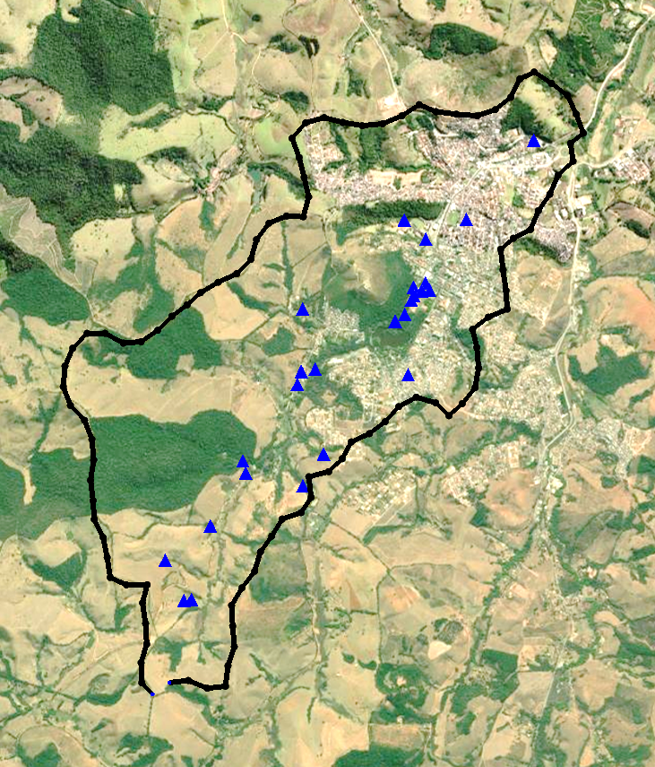
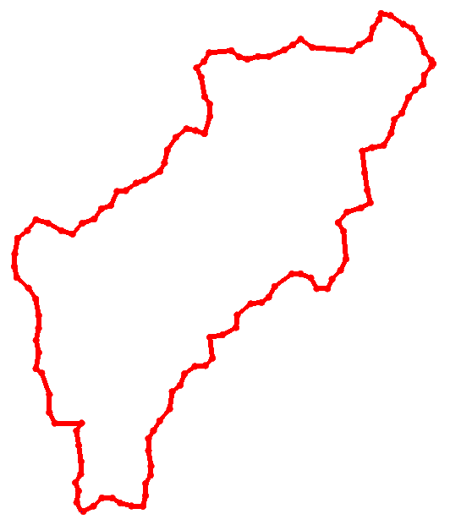
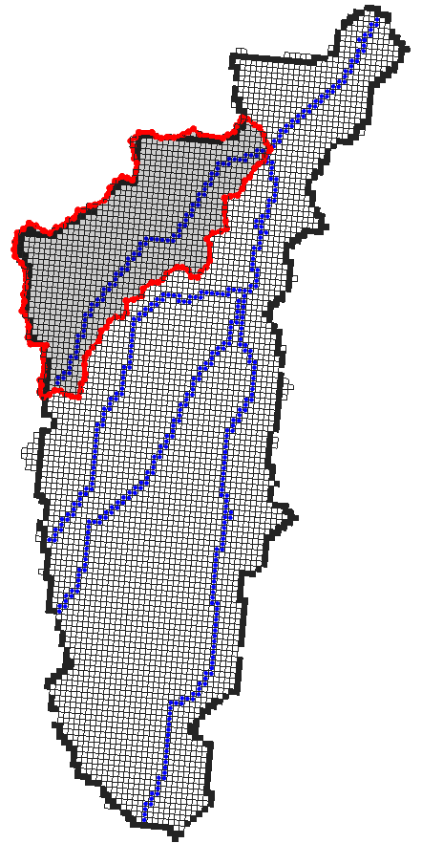
Base de dados Φ
Vazões e Áreas de Contribuição
Cargas Hidráulicas
(m)
L/h
Type | ID | x | y | topo | P | Q
NC | 13 | 506474 | 7568611 | 937 | - | 77.1
NC | 17 | 506440 | 7569932 | 898 | - | 360
NC | 18 | 506625 | 7569767 | 899 | - | 360
NC | 21 | 504399 | 7567028 | 953 | - | 180
NC | 24 | 505574 | 7567662 | 924 | - | 3600
NC | 25 | 505751 | 7567935 | 924 | - | 3600
NC | 27 | 505087 | 7567772 | 912 | - | 72
NC | 28 | 504785 | 7567322 | 925 | - | 10800
NC | 30 | 505573 | 7569171 | 908 | - | 10000
Curso H₂O | 32 | 505680 | 7568657 | 895 | - | 50000
CT | 1 | 506362 | 7569067 | 906 | 7 | 270
CT | 2 | 506363 | 7569068 | 906 | 6 | 470
CT | 4 | 506364 | 7569069 | 906 | 6 | 440
CT | 5 | 506589 | 7569328 | 888 | 6 | 80
CT | 6 | 506445 | 7569125 | 903 | 15 | 850
CT | 8 | 506659 | 7569330 | 891 | 6 | 112
CT | 9 | 506622 | 7569394 | 891 | 10 | 340
CT | 10 | 506501 | 7569248 | 888 | 9 | 1030
CT | 11 | 506521 | 7569286 | 891 | 9 | 470
PM | 19 | 504623 | 7566694 | 937 | 6 | 360
PM | 20 | 504558 | 7566683 | 947 | 6 | 1000
PT | 22 | 506911 | 7569974 | 885 | 12 | 3000
PT | 23 | 505561 | 7568640 | 898 | 10 | 3000
PM | 29 | 505685 | 7568847 | 901 | 12 | sd
PM | 31 | 505528 | 7568528 | 902 | 3 | 3000
PZ | 33 | 506368 | 7569064 | 906 | sd | sd
PZ | 34 | 506357 | 7569063 | 906 | sd | sd
Ribeirão Bengo
Córrego Mombava
Córrego Cachoeira
Ribeirão da Cachoeirinha
Ribeirão da Cachoeirinha
Ribeirão João Pedro
6
Caxambu
5
1
2
3
Vazões estimadas: Córrego Bengo e afluentes
45°
4
Fontes: IGAM | Codemge | SIGA
2024 - www.betami.com.br
Beta μ
Notes:
The database.
The present calibration solution accounts for 17 monitoring wells, 10 natural water springs and a distribution of Ribeirão (river) Bengo flow to sections and affluents.
27 groundwater observations were used as referential points (out of a list of 34), plus a total steady state watercourse's volume and a expected recharge rate.
Actually, any or very little hydraulic heads have been formalized in the original report (SIGA). Anyway, to emerge, the springs must have hydraulic Heads, thus the nominal expected values (the MED or Targets observation for these Heads) took the form of the tabulated variable “topo” minus a 6 meter constant adjustment. The same for the [Heads of the Wells], its tabulated values “topo” minus the measured [P, for filters maybe], minus a 8 meter constant adjustment. Aside from these highly speculative presumptions, it proved to be a reassuring reasoning, due the still great amplitude of measures to be reached by the calibration (66 meters).

Slide 6
Calibração
Observações
O modelo numérico é uma maquete virtual, aponta o caminho da água, como
na corrente elétrica (Ampère) movida
pela diferença de potencial, a
tenção (Volts) entre dois pontos
separados pela resistência Ω (Ohm).
E toda calibração é uma tarefa Bayesiana.
Seja ela feita de modo ponderado ou intuitivo.
A escolha dos
parâmetros depende,
necessariamente,
de objetivos a serem
perseguidos.
Seu resultado depende
dos pontos de referência.
Resultado - MOD
Heads
Erro, 6%
Referência - MED
2024 - www.betami.com.br
Beta μ
Notes:
Be that as it may, any form of calibration is a Bayesian task. Whether it is done in a deliberate or intuitive way.
Here The Calibration Process in a more structured, autonomous disposition, becomes the Mathematical Regularization.
The issue is that while a greater number of parameters empowers the numerical representation of the reality (for good). Finding the best combination of it becomes a increasing tougher task. - What's at stake is that a list of parameters (PAR) need to be selected according to a list o observations (OBS).
[Probability and Cumulative Distribution Functions – the Beta contribution] - So, a way to soften this assignment is attaching PDF / CDF derived statistics obtained, in its turn, from the shape or distribution of targets (MED-OBS), or even better, from the supposed distance between previous and posterior observations (MED - MOD).
There is a algorithm which takes advantage of this information. PEST optimizes the calibration search.

Slide 7
Parâmetros
Calibração
Observações
Parâmetros
Sensibilidades
...
Função Objetivo
Balanço de Massa
OBS
PAR
Sensibilidades
2024 - www.betami.com.br
Beta μ
Notes:
… so there is a algorithm that optimizes this calibration search. PEST moves the parameters up and down in a pre-defined, reasonable, authorized amplitude.
It runs a prior MODFLOW batch many times, separately, once for each listed parameter, not forgetting to set down the whole compound of sensibilities, to identify the key parameters in regard of its action (or the lack of it) on reaching some desirable value (in its turn previously stablished) at the observation list.
I mean, parameters and observations, each one has its own sensibilities. Or in a more suitable manner for the second term, it one has its own susceptibilities.
There is, each observation, being that a Head, a boundary condition flux or usually a combination of many of its kind, applies a given stress in asking, pledging a given parameter or a whole list of then, to attend those pre-established demands.

Slide 8
Sensibilidades
Calibração
SEN_PAR
A escolha da melhor combinação de parâmetros.
Procedimentos que guiam a tomada de decisão.
_____________________________
SEN_PAR
P(±)
Changes (ABS) x (Relative)
SEO
SEN
_PAR
x
SEO
_OBS
P(÷)
SEN
2024 - www.betami.com.br
Beta μ
Notes:
Here we go; - This charts delivers the matrixial contents of all sensibilities, a result made possible only after a given kind of full MODFLOW | PEST realization.
First we took note that every and each observation has a susceptibility, the SEO information for Heads, Drains and GHB conditions. Then in tandem there is all the parameter sensibilities, the SEN value showing its hardships in trying to answer an observed demand. This is Bayesian, sorry, we can’t avoid # circular reference!
So the next figures brings SEO and SEN variables separately, together with an momentous set of made choices (parameter modifications) made by the cited algorithms.
And finally we have just two increasingly condensed lists of the same information's.
Note the low, even distribution of small sensibilities covering the whole set of variables. In a way, this result address an unbiased solution. Or at least, by a mere question of database organization, guides de user towards a more reasonable set of expectations.

Slide 9
Função Objetivo
Calibração
Seguem os pesos necessários no balanço da função objetivo.
E um resultado que demonstra como as vazões GHB, vindas de fora da bacia, podem sustentar o fluxo DRN.
Balanço de Massa
(m³/d)
IN
OUT
IN
OUT
Balanço de massa:
Condições de contorno (m³/d)
2024 - www.betami.com.br
Beta μ
Notes:
Bring back the Observations subject, being it the true on site reference points, the Heads. Or being it some speculative ones, the estimated flow rate of all the river tributaries. Or even worst, the unknown GHB flow rates through the fractures, … This objective function Φ chart has two contributions to make:
It got the normalized absolute difference of all observations, regardless the type (Heads or fluxes), just a comparison of all magnitudes. Then the secondary axis convey a more adequate (MODFLOW appliable) balance of the weights of each observation, to guide the estimation process. The following chart summers it up.
Finally, this mass balance shows how the calibrated fluxes meets the expect fluxes.
Being the GHB water contribution (not the 5% recharge of this small basin), undoubtedly connected to the bulk of water caried away by the drains.

Slide 10
Calibração – Fundamentação teórica – Função Objetivo
Aqui, uma exemplo idealizado de manejo dos pesos (weights) associados às observações.
Valor utilizado CPF PDF
MED
MOD
O meio é a mensagem.
2024 - www.betami.com.br
Beta μ
Notes:
Perhaps the reader can feel more comfortable in seeing a regular distribution of “observations”, three actually, after the same earlier conceptual modeling structure.
Imagine a ideal situation of a full MODFLOW | PEST symmetry. Then actually, we see a thousandfold bigger, neat distribution of drain observed fluxes. So what happens to the compared weights, and thus to the objective function, when the grouped absolute magnitudes diverges from it other?
It would be easier to answer if Confidence Interval or Standard Deviation became factored by the inverse term of observed magnitudes (see the SD, in chart one).
But as we have restrictions imposed by the STD analysis. The weighting proceedings must be made outside this data scheme.
So an isolated, foreign multiplication factor, is required to balance those weights. Anyway, note how the strongest weights are imposed within the average differences of the inner DRN distribution. So the calibration driven concerns stays away from extreme outlier values.

Slide 11
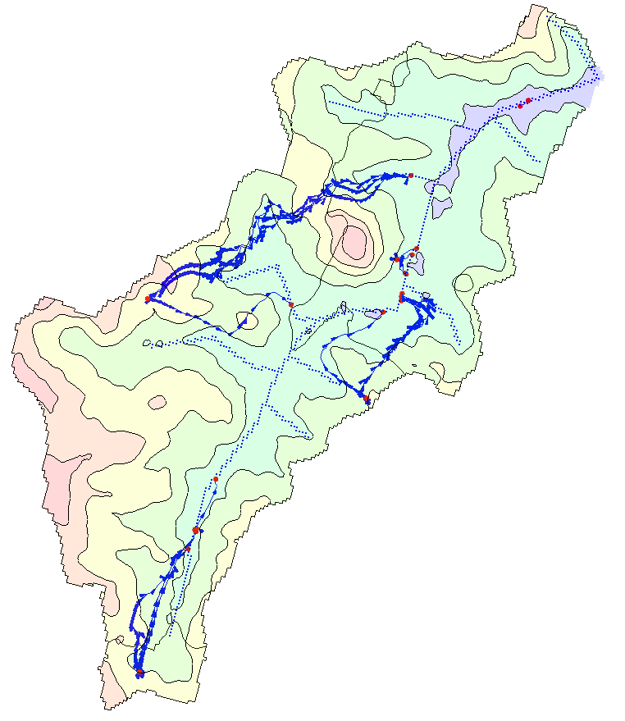
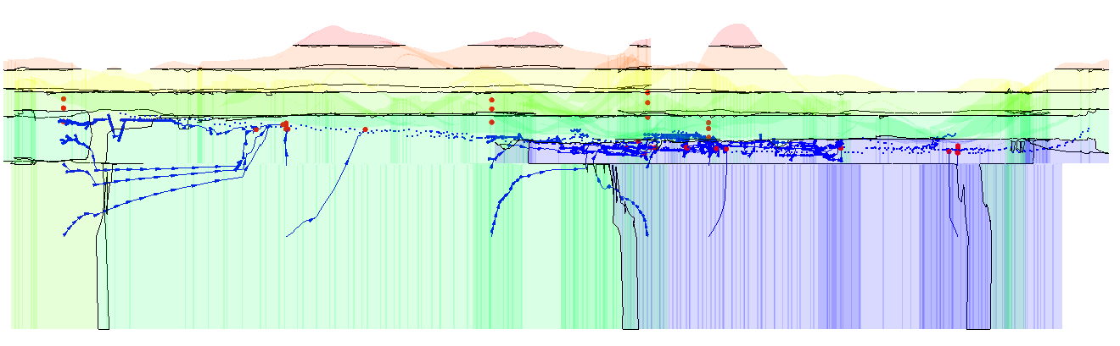
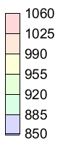
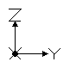
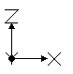
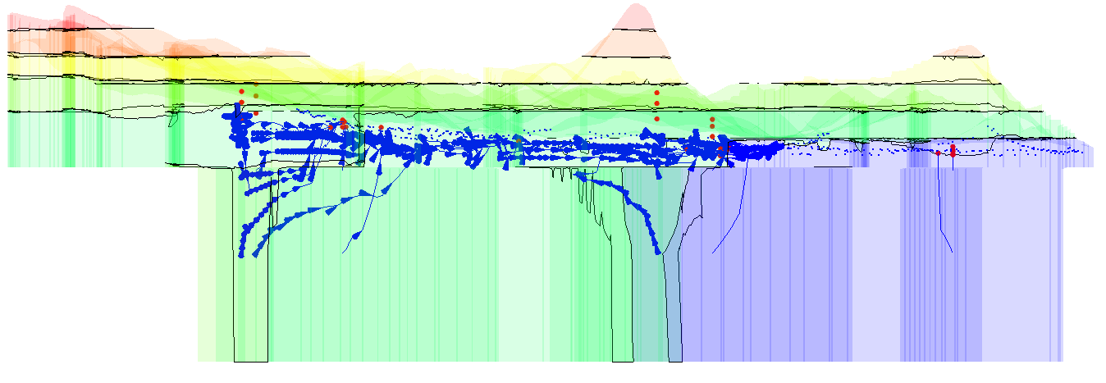
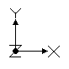
Resultado
Cargas
Hidráulicas
Vazões
Bengo e Afluentes
Drenos DRN - Magnitude total compatível.
GHB → DRN – Transferência, ascensão da água, aporte regional para rio efluente.
IN
OUT
Previstas Calibradas
2024 - www.betami.com.br
Beta μ
Notes:
The ultimate result are a potentiometric map for any hydraulic head within the domain. It comes as well with 10 years travelling time Particle Tracking observations.
This findings reinforces, strongly, the possibilities of ascending water paths from the fractured to the porous aquifers.
During the simulation, an attempt to increase in various orders of magnitude the hydraulic conductivity of the two materials at the lower layers made possible the water recirculation within the watershed, but the modelled sensibilities become mathematically too rough, rendering a not so good mass balance performance.
The Heads calibration were particularly good; Drain (DRN) fluxes, besides punctual discrepancies, marched total expected volumes, the same for the recharge values.
And as it comes to the General Heads (GHB), its proposed targets, amplitudes, as well as the weighs of these observations as a group, … were loosely put, to lower any eventual influence on the calibration tool.

Slide 12
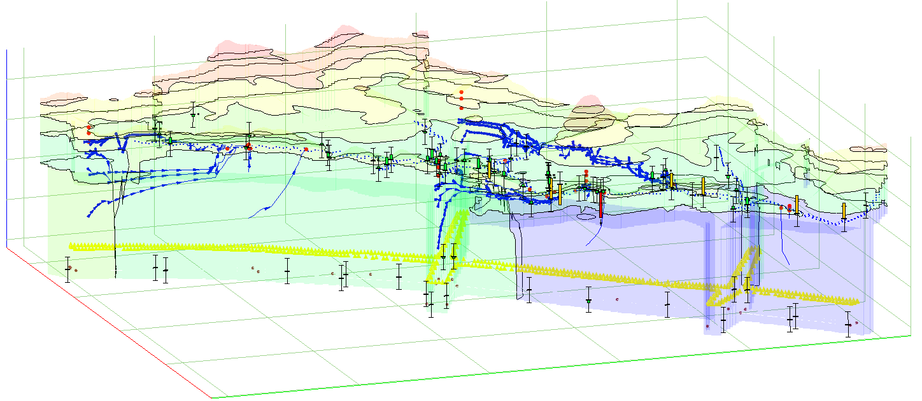
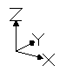
Resultado
A
B
C
D
E
m/d
KH
KV
IN
OUT
K
P^{th}
10%
K
P^{th}
90%
Cargas
Hidráulicas
Grato pela atenção!
2024 - www.betami.com.br
Beta μ
Notes:
Lets compare the results again, now with the hydraulic conductivities.
As expected, the simulation highlights a contrast in horizontal end vertical flow pattens between the shallower and the deeper aquifers;
So what about these kind of modeling exercise practical utilities?
The regulation of water demands, management and design of government grants is a option. Or for comertial porpuses, it can help the alocation of new wells.
One disclaim: This model / report is just an free style interpretation of promptly and open source available information (The Codemge | SIGA report).
And some acclaims: Much more can be implemented here on: A transient model version of it, considering pumping rates would be a next natural step to take; Other alternative is to build a reactive model to shed more light in the chemical process of so unusual natural springs. More attention must be paid to the sediments of the alluvion process and its organic matter contents. Maybe a different strategy to deal with the fractures. Or a whole new model increasing the watershed scale. ...
But that’s it for now.
And a last word: I would like to express my appreciation for your support GMS | Aquaveo.

Slide 13
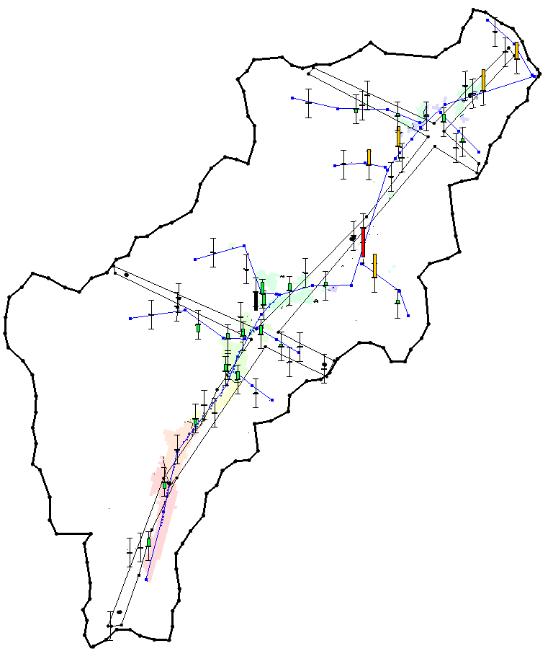
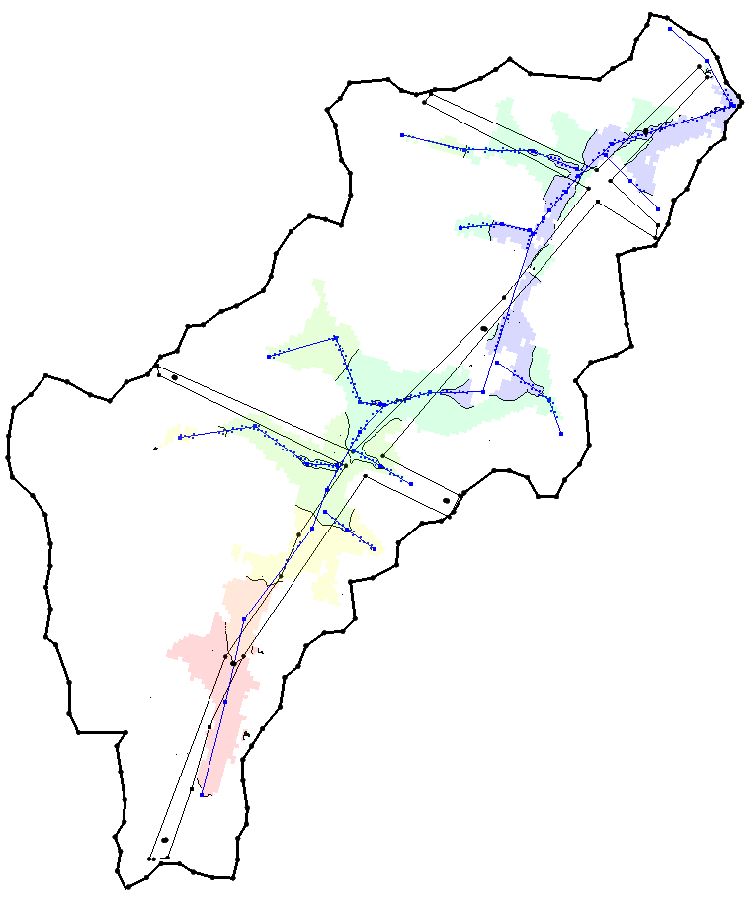
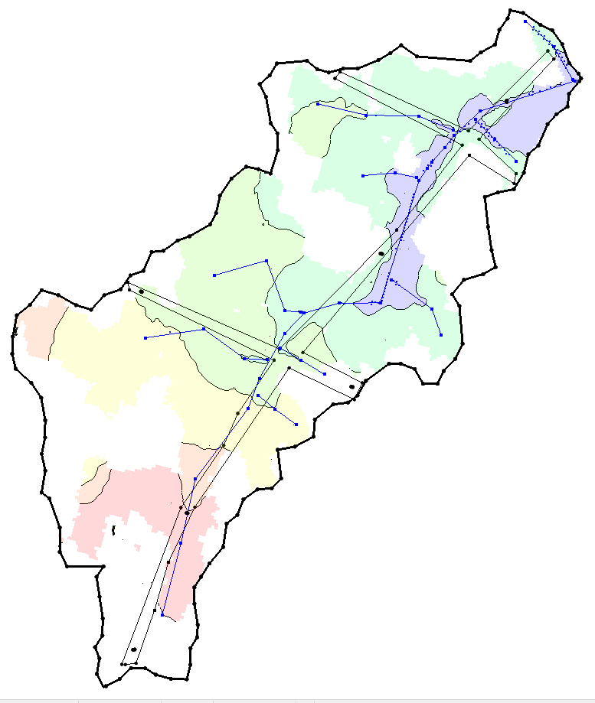
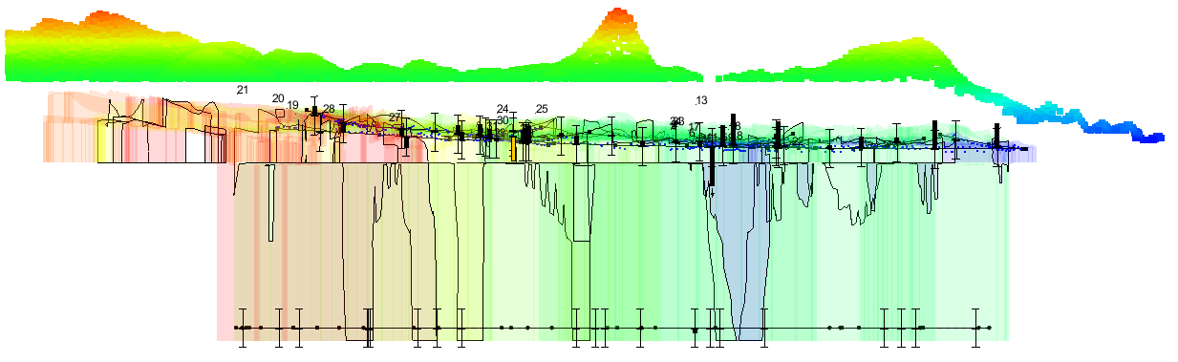
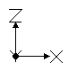
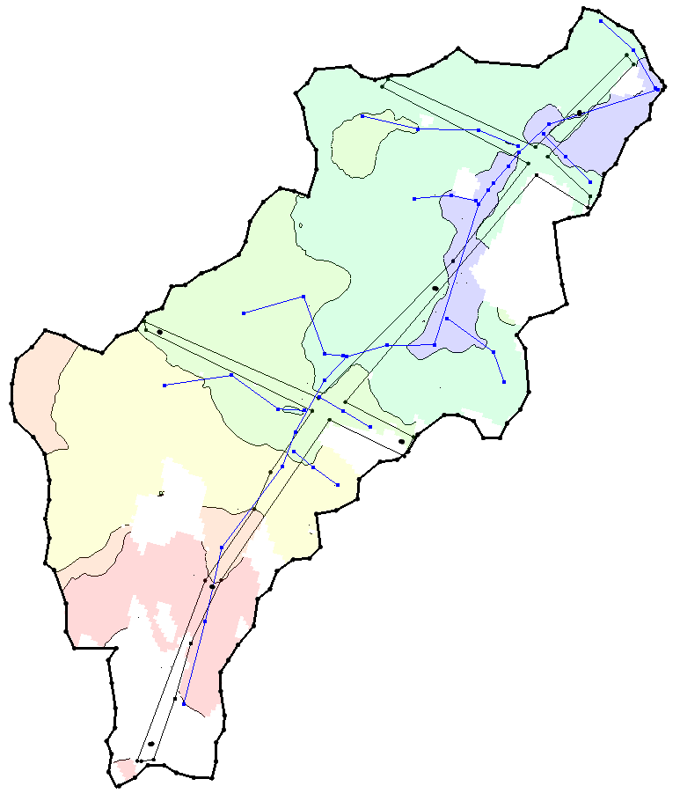
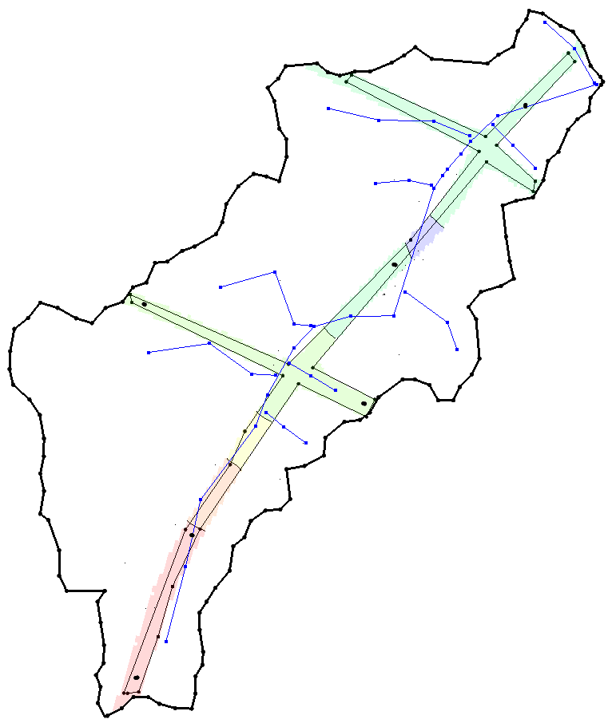
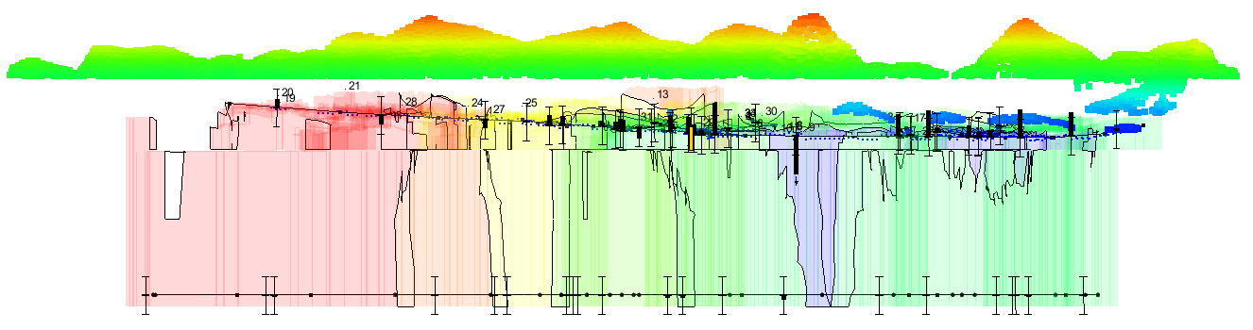
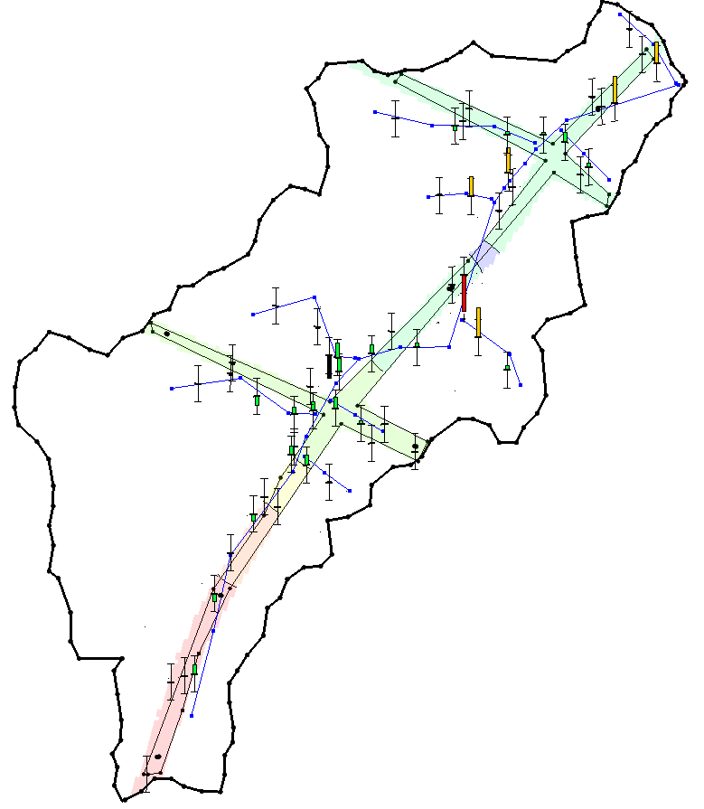
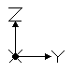
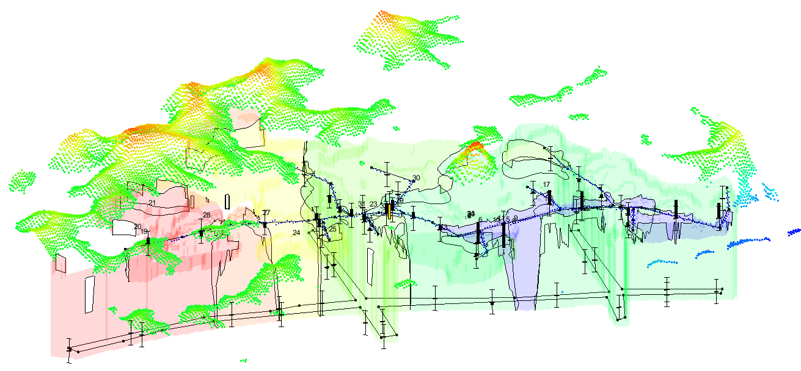
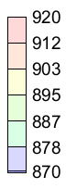
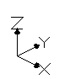
Heads of Numerical Layers 2 -7
02 03 04
05 06 07
Foreword (HDRYBOT-Off) PEST_ASP Option
(plus topograph sample)
2024 - www.betami.com.br
Beta μ

